Slide 1
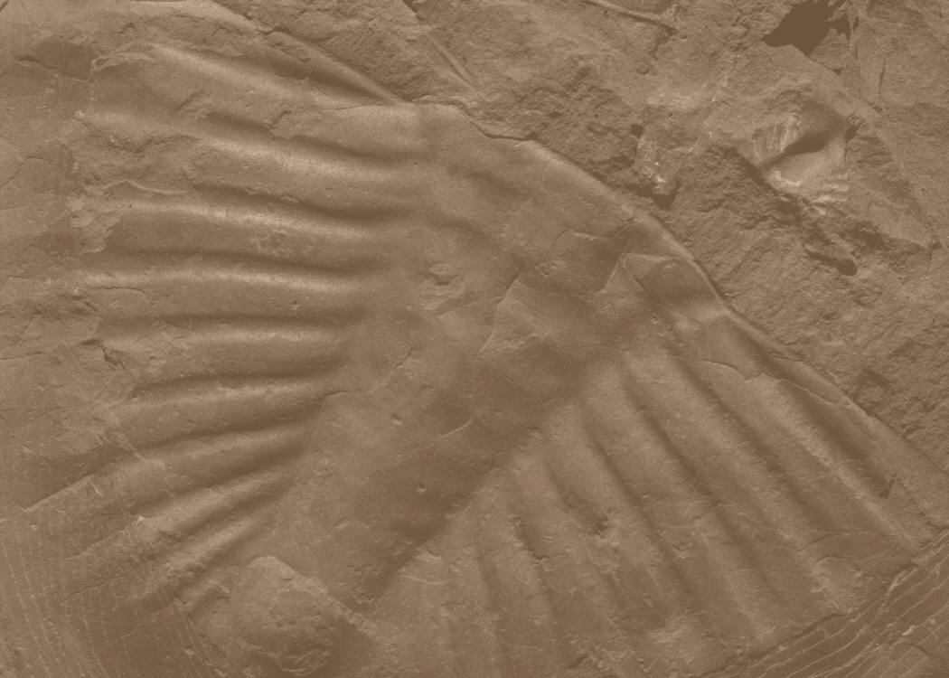

Selecting a Science Elective

Slide 2
Life
Earth
Physical
The Branches of Science

Slide 3
8 Semester Credits Required
At least one laboratory course
Scientific method applied to understand natural phenomena and their causes

Slide 4
Scientific Method
Hypothesis
Experiment
Observation
Theory

